Slide 1

Azure Blueprints & Azure Policy au service de la gouvernance
Yoann GUILLO

Slide 2
Merci à nos sponsors locaux
William BORDES
Yoann GUILLO

Slide 3










Merci à nos sponsors internationaux

Slide 4

Meet the Team
Yoann GUILLO
Architecte Cloud Azure
MVP Azure / Freelance
Membre de la communauté aOS & MUG Rennes
@YoannGUILLO
https://www.linkedin.com/in/yoannguillo
http://www.geneziis.com

Slide 5


All attendees get the following :
Sponsor | Offering
Cloudmonix https://cloudmonix.com | Cloudmonix offers 2 months free of Ultimate or Pro plans for Azure monitoring! http://bit.ly/globalazure2019-cloudmonix Code: GAB2019
Serverless 360 https://serverless360.com | Serverless360 is offering a limited time Gold plan for free! http://bit.ly/globalazure2019-serverless360
KEMP https://kemptechnologies.com | Kemp is providing a trial of their LoadMaster (load balancer) tool, as well as a free Kemp 360 License to all attendees! http://bit.ly/globalazure2019-kemploadmaster http://bit.ly/globalazure2019-kemp360

Slide 6


All attendees get the following :
Sponsor | Offering
Progate https://progate.com | Progate is offering a free month access to their entire platform! http://bit.ly/progateaccessgab2019
RevDeBug https://revdebug.com/ | RevDeBug is offering an enterprise license for 3 months for ALL attendees! http://bit.ly/globalazure2019-revdebug

Slide 7

La gouvernance ? Pourquoi faire ?

Slide 8
Management Groups

Slide 9


Azure Management Groups
Organize your resources with Azure Management Groups
Manage your resources with management
Tenant Root Group
Dev and Test Group
Production Group
Dev and Test Subscription
Production Subscription

Slide 10


DEMO
DEMO
DEMO



Slide 11
Azure Policy

Slide 12
Azure Policy
Pourquoi ?
Empêcher ces fichus mes amis développeurs de faire n’importe quoi ☺
Limiter les choix :
Sizing VMs
Localisation
DB versions
Mettre en place des audits
Vérifier / appliquer des conventions de nommage
Définir des tags par défaut
Mise en conformité

Slide 13
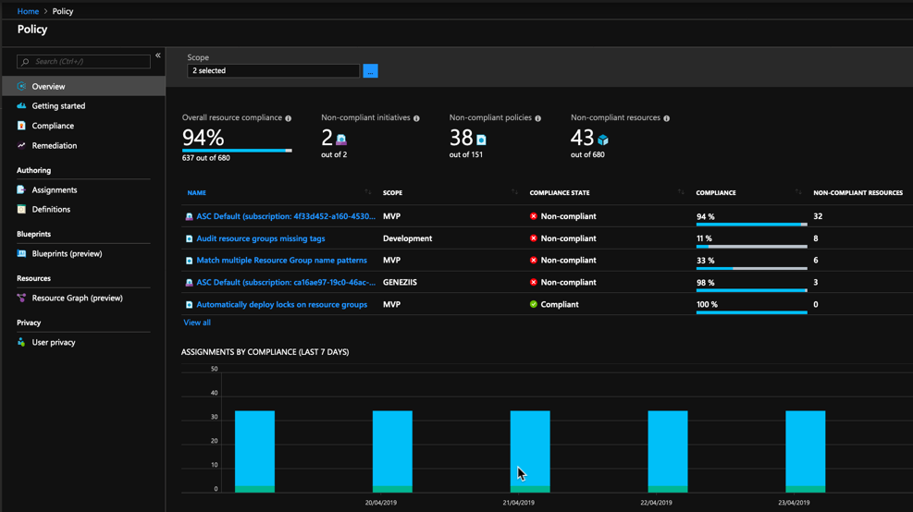
Azure Policy
Overview of the Azure Policy service
Azure Policy definition structure
Azure Policy & DevOps
GitHub official templates
GItHub GAB 2019

Slide 14


DEMO
DEMO
DEMO



Slide 15
Azure Blueprints

Slide 16
Azure Blueprints
Pourquoi ?
Moyen déclaratif de déployer des artifacts tels que :
Role Assignments
Policy Assignments
Azure Resource Manager templates
Resource Groups
Overview of the Azure Blueprints service
GitHub Blueprints official templates

Slide 17


DEMO
DEMO
DEMO



Slide 18
Merci
d’être venus
A bientôt !

